Slide 1

Scanner Device Identification Using Document Images
AITracker – Project Presentation
Pratik Ekashinge
Notes:
1

Slide 2

Background & Problem Statement
During the document scanning process, hardware-level imperfections introduce subtle distortions into the resulting digital images. These distortions—originating from sensors, optics, and internal signal processing—are not visible to humans but remain consistently tied to the scanner device.
Identifying these hidden patterns enables reliable attribution of a scanned document to its source device, which is a key requirement in digital forensics and document verification.
Notes:
2

Slide 3

Project Objective
To build an automated system that determines the scanner brand responsible for a scanned document by learning device-specific artifacts using machine learning and deep learning models.
Notes:
3

Slide 4
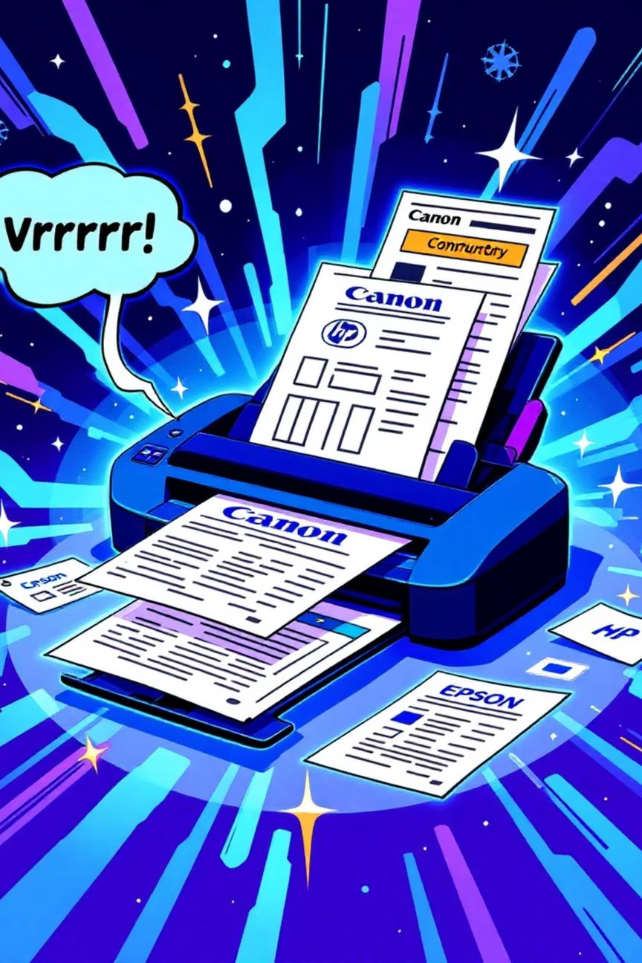
Dataset Description
Data Collection Strategy
A multi-device dataset was created by scanning documents using commercially available scanners from different manufacturers.
Dataset Highlights
More than 1000 document images
Scanner brands include Canon, HP, and Epson
Images acquired at 150 DPI and 300 DPI
Stored in lossless TIFF format to preserve noise patterns
Manually annotated with scanner brand labels
Notes:
4

Slide 5

Preprocessing Methodology
A unified preprocessing pipeline was designed to ensure consistency and artifact preservation across all samples.
1
2
3
Grayscale transformation to emphasize texture information
Image resizing for uniform model input
Pixel intensity normalization to stabilize training
4
5
Dedicated handling of high-resolution TIFF images
Dataset-wide verification to avoid preprocessing bias
Notes:
5

Slide 6

Classical Machine Learning Approach
Feature Representation
Local texture descriptors were computed to capture scanner-induced micro-level variations present in background regions of scanned documents.
These descriptors are effective in representing fine-grained noise structures introduced during scanning.
Notes:
6

Slide 7
Random Forest Classifier
Why Random Forest?
Experimental Outcome
Random Forest was selected due to its:
High accuracy achieved when training and testing at the same resolution
Strong performance on high-dimensional handcrafted features
Noticeable degradation when mixing different DPI values
Robustness to noise and overfitting
Ability to model complex decision boundaries through ensemble learning
Demonstrated sensitivity of handcrafted features to resolution changes
This limitation motivated the transition to deep learning-based solutions.
Notes:
7

Slide 8

Deep Learning Framework
CNN Trained from Scratch
Initial CNN experiments suffered from underfitting caused by limited data availability, with performance stabilizing at relatively low accuracy levels.
Notes:
8

Slide 9


Transfer Learning Strategy
Performance Improvement
Pre-trained convolutional architectures were adopted
Transfer learning significantly enhanced classification accuracy and generalization across mixed-resolution datasets.
Model layers were fine-tuned on scanner-specific data
Data augmentation techniques improved diversity and robustness
Notes:
9

Slide 10

Model Interpretability
Explainability Using Grad-CAM
Observed Behavior
To ensure forensic reliability, visual explanation techniques were applied to analyze CNN predictions.
Model attention primarily focused on background and margin regions
Text content contributed minimally to predictions
Strong activation patterns aligned with noise-dominated areas
These findings confirm that the model learns scanner-specific artifacts rather than document semantics.
Notes:
10

Slide 11
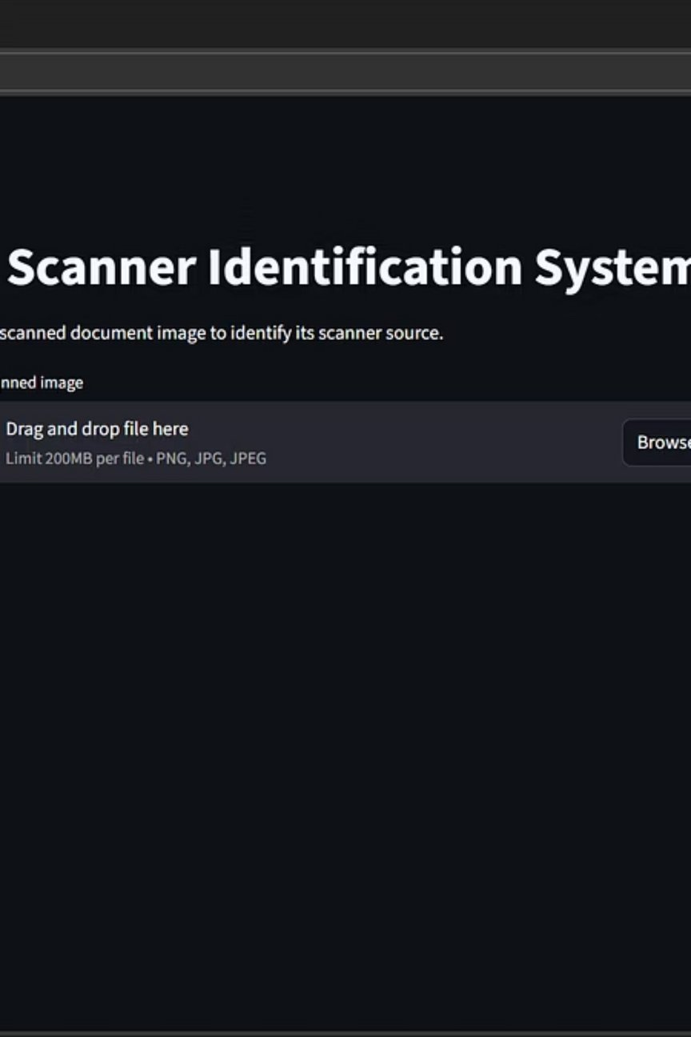
Deployment Demonstration
Web-Based Inference System
A lightweight web interface was developed to demonstrate real-time scanner prediction.
System Capabilities:
Upload scanned document images
Perform consistent preprocessing
Output scanner brand predictions with confidence.
Notes:
11

Slide 12

Key Results & Insights
Random Forest performed well under controlled resolution settings
Deep learning models provided superior robustness
Transfer learning was critical for small forensic datasets
Complete pipeline successfully validated from data ingestion to deployment.
Notes:
12

Slide 13

Practical Applications
Document authenticity verification
Fraud and forgery detection
Forensic source attribution
Legal and institutional investigations
Notes:
13

Slide 14

Future Scope
1
2
3
Expansion to additional scanner models
Extension to printer and copier identification
Cross-device generalization studies
Integration with document verification platforms
Notes:
14

Slide 15
Future Enhancements
• Cloud deployment using AWS / GCP
• REST API integration using FastAPI
• Multi-scanner and brand-level classification
• Explainability using Grad-CAM visualization
• Secure user authentication and access control
Notes:
15

Slide 16

Thank You
Notes:
16

